Slide 1
COMP90015: Distributed Systems
Dr. Rajkumar Buyya
Redmond Barry Distinguished Professor & Director
Cloud Computing and Distributed Systems (CLOUDS) Laboratory
School of Computing and Information Systems
The University of Melbourne, Australia
http://www.buyya.com

Slide 2
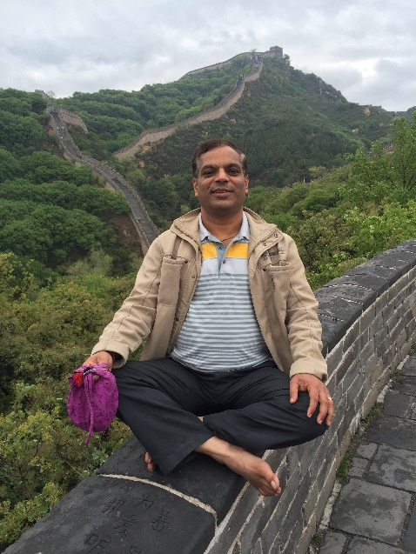
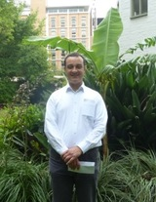
Teaching Staff
Lecturer 1: Prof. Rajkumar Buyya
  1st Half of Subject + Assignment 1
  Email: rbuyya@unimelb.edu.au
  Office: 7.22 (Doug McDonnell Building)
    Discussion: Prefer you catch me after the lecture.
Lecturer 2: A/Prof. Egemen Tanin
  2nd Half of Subject + Assignment 2
  Email: etanin@unimelb.edu.au
  Office: 6.02 (Doug McDonnell Building)
Raj’s Consulting Time: 4:30-5:30pm every Wed (on working days only) – 1st half of Semester!
  NO appointment required (so NO emails, please!). First come first served in our room!
Egemen Consulting Time: He will inform later.

Slide 3
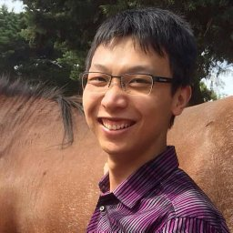
Tutors
Head Tutor: Dr. Xunyun Liu
  Handles lectures in my absence and assists with labs/projects.
  Email: xunyun@unimelb.edu.au
  Office: 7.12 (Doug McDonnell Building)
Consulting Time: Wednesday – 4:30-5:30 (on working days only) – we both handle
  NO appointment required (so NO emails, please!).
  First come first served!
  Also, if you don’t see Raj, talk to Dr. Xunyun.

Slide 4
Tutors (5)
Handle all tutorials/workshops, assisting with labs/projects and marking of assignments (associated with their tutorials)
  Xunyun Liu: xunyun@unimelb.edu.au
  Lakshmi Jagathamma Mohan:l.jagathammamohan@student.unimelb.edu.au
  Minxian Xu: minxianx@student.unimelb.edu.au
  Alisha Aneja: aaneja@student.unimelb.edu.au
  Shashikant Ilager: silager@student.unimelb.edu.au

Slide 5
Web and Course Schedule
Course Web Site:
  http://cloudbus.cis.unimelb.edu.au/652/
  http://www.cloudbus.org/652
  Note: LMS gives link to this.
  All announcements, notes, etc. via this page only. LMS can be used for discussion list only for assignments.
Lectures:
  Time:
    Tuesday: 2:15-4.15pm - 2 hours – with 5-10 minute break.
    Venue: PAR-Medical-C403 (Wright Theatre)
Workshops/Tutorials – 15
    Each session accommodate ~22+; Must attend your own Tutorial
    Please make friends – your A2 team members come from here!
Notes:
Course page has not yet been updated, will be by the end of the week
This is were all the important information will reside - the latest lecture nodes, assignments, marking guides, sample exams, so check it regularly!

Slide 6
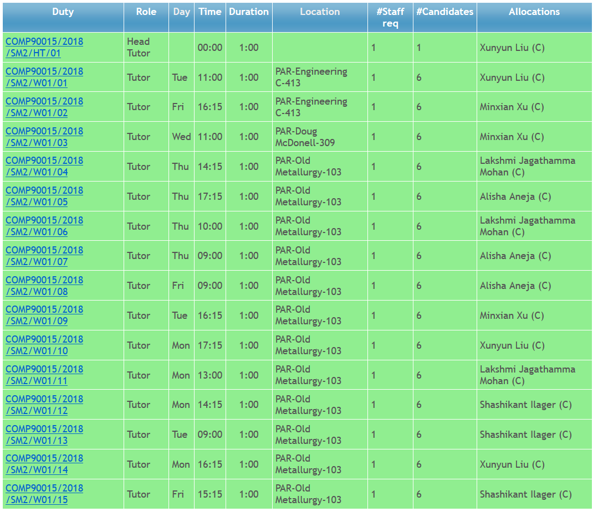

Tutorials: Time, Venue and Tutors

Slide 7

Wide-Background of Students???
Master of IT
  MIT (Comp), MEDC/MIT (DC), MIT (SI), MIT (Health)
    MIT (Distributed Computing) – foundation subject.
MSc (Computer Science)
ME (Software Engineering)
Master of Data Science
++ Students from all over the world joining our Masters programs.
So, please understand that we are trying our best to satisfy all of you although it is difficult to please everyone ☺

Slide 8
Background expectation
Pre-requisites:
  COMP90041 Programming and Software Development (Java)
  COMP90038 Algorithms and Data Structures
  COMP90007 Internet Technologies (No Sockets/Threads taught)
  OR Equivalent subjects
If you know “MORE” than pre-requisite subjects, then this subject is NOT for you.
  Better take Advanced related/follow-up subject if you know “More” than pre-requisite subject coverage (e.g., UniMelb: OS and Network Services).

Slide 9
DS subject is a “foundation” (pre-requisite) for many advanced subjects
Distributed Algorithms
Cluster and Cloud Computing
Mobile Computing Systems Programming
Distributed Computing Project (for MIT(DC))
Sensor Networks and Applications
Parallel and Multi-core Computing
Some special offerings:
  Stream Computing?
  Management and Mining of Spatio-Temporal Data (MapReduce application)

Slide 10

Why study distributed computing now?
We have started MEDC, now MIT(DC) degree at a time when distributed systems, particularly the Web and Internet applications and services, are of unprecedented interest and importance.
  Microsoft .NET
  HP Adaptive Enterprise
  Oracle – Oracle 10g / 11g / 12c
  IBM – On Demand
  SAP – enterprise management software
  Cloud Computing: EC2, Azure, GoogleAppEngine, Aneka, Force.com...
  Academic R&D worldwide: Service computing, e-Science, etc.
The DC degree and this subject in particular aims to convey insight into, and knowledge of the principles and practice underlying the design of distributed systems.
The depth covered in this subject enables you to evaluate existing systems or design new ones.
Notes:
Upon completion, a graduate of the program should have:
*expertise in Internet programming and distributed computing,
*be able to apply acquired techniques and knowledge to contribute to the development and implementation of enterprise software systems,
*be able to analyse and design ICT projects and future ICT needs, and
*be able to apply Internet-based distributed computing systems and algorithms to e-Science and e-Business applications.

Slide 11
DS Subject Overview
Part I: Foundations – approx. 5 weeks
  Introduction, Inter-process Communication, Socket and Thread Programming, and System Models
Part II: Programming and Principles – 4 weeks
  Distributed Objects and Programming,
  Operating System support services, Distributed Shared Memory Systems
Part III: Paradigms/Platforms - 3 weeks:
  RMI, Kerberos, NFS etc. taught during Part I & II
  Distributed File Systems, Security and Naming Services
Guest Lectures / Advanced Topics (not in exam)
  CDN, Cloud, and industrial applications
Depth of some parts may be reduced as the Dept. has dedicated subjects on some of these topics:
  Distributed Algorithms, Software Systems Security, Cluster and Cloud Computing, High-Performance Database Systems

Slide 12
Course Assessment
Project work and some short assignments:
  During semester worth 40%
    Assignment 1 (Single): 15%
    Assignment 2 (Group): 25%
Written examination:
  A written examination (three hours) at the end of the semester worth 60%
All components must be completed satisfactorily (50% marks) to pass the subject.
Notes:
Each assessment is a hurdle - you must at least pass!

Slide 13
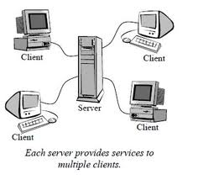
Assignment 1
Multi-Threaded Dictionary Server
  Design and Implementation of a Simple Multi-Threaded Distributed System Supporting Access to a Remote Dictionary
Aim:
  Enhance Understanding of Socket Programming and Multi-Threading
  Gain experience in implementing a simple distributed, client server application.
  “Using a client-server architecture, design and implement a multi-threaded server that returns the meaning of a word as stored in a remote dictionary.”
  Do some smart design/architecture (networking, storage)!
Notes:
You can decide the best networking protocol to use (e.g. TCP/UDP), the best and most efficient message format, and how to optimally store the dictionary for fast lookups.

Slide 14
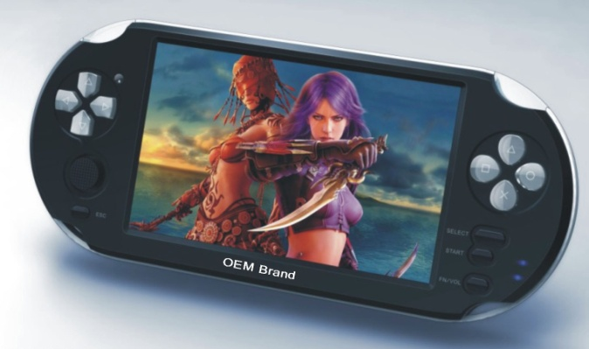
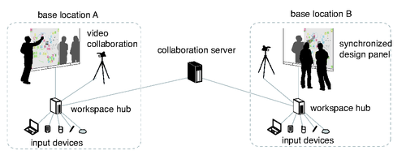
Assignment 2
Distributed Applications Project
  To be decided:
    Distributed, Shared White Board
    OR Net Games along with a chat box.
Team Size: 4 (Strongly recommended)
  You choose your own partner (from Tutorial Group)
You are given a chance to show some creative thinking / architecture (e.g. you can “use client/server or P2P”, “TCP or UDP”)
Multi-stage project, assessed at each stage
Notes:
Car race - like ‘Need for Speed’ or similar racing game. Players should be able host games, join games, and race against each other over the network
White Board - like netmeeting or other online collaborative white board. This might include a shared board, text chat, user authentication, etc.
Students were very innovative last year (security, 3d gfx, p2p approach)

Slide 15
Computational Resources
Your laptop!
  Use it for both assignments..
Uni. Computing Resources:
  Can also be used for simple assignments and learning
  For demonstration of assignments (along with your own laptops)
Notes:
GRIDS Lab is located ….

Slide 16
Books and References
Main Text Book:
  CDK: Couloris, G, Dollimore, J. and Kinberg, T, Distributed Systems - Concepts and Design, 5th Edition, Addison-Wesley, Pearson Education, UK, ISBN
  0132-143-011. http://www.cdk5.net
Programming Reference:
  R. Buyya, S. Selvi, X. Chu, “Object Oriented Programming with Java: Essentials and Applications”, McGraw Hill, New Delhi, India, 2009.
  Sample chapters at book website: http://www.buyya.com/java/
Research Articles:
  To be supplied by the Lecturer (if used)!
Notes:
CDK is the main text book - it covers the key topics in depth

Slide 17
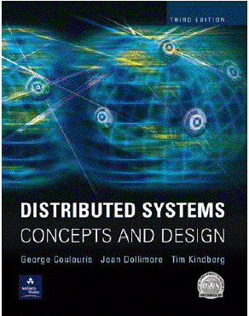
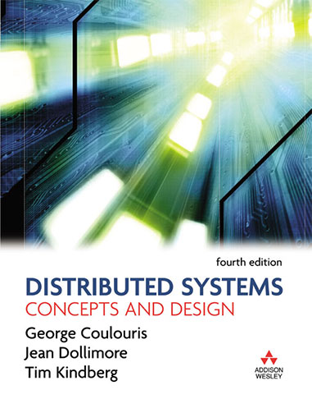
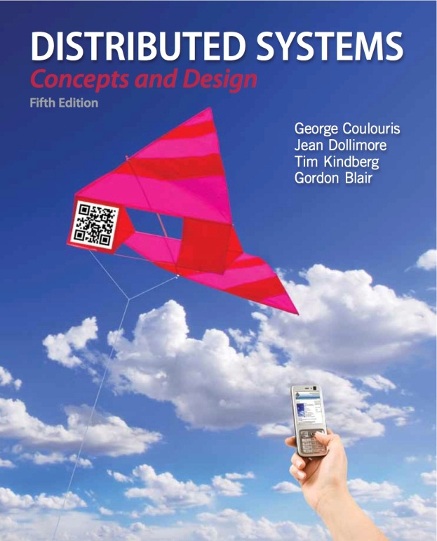
Text Book
G. Couloris, J. Dollimore, T. Kinberg, and G. Blair, Distributed Systems - Concepts and Design,
5th Edition, Addison-Wesley/Pearson Education, UK, 2011. http://www.cdk5.net

Slide 18
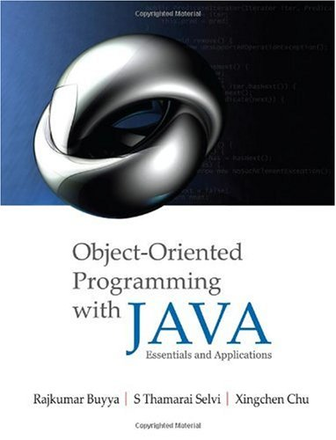
Programming Reference
  Buyya, R. Selvi, S.T., Chu, X.,
  Object Oriented Programming with Java: Essentials and Applications, McGraw Hill, New Delhi, India, 2009.
  Sample chapters at book website: http://www.buyya.com/java/

Slide 19
Presentation Slides
Usually on the web before lecture
They may be updated slightly a day before the lecture to reflect recent developments
  No need to read Today’s lecture content beforehand!
  You only need to read & understand previous lecture!
  Do online Quiz (Multiple choice test) on previous lecture topic prior to tutorial –ask Q on difficult topic from quiz.
Mostly derived from the text book.
  Please procure (or own) the prescribed textbook.
Good ideas and figures from alternative text book or reference may also be used.

Slide 20
What do we expect from you?
1. Regular attendance of lectures
  Pay full attention, be enthusiastic, fully committed to learn new things, ask questions during the class, participate in discussion.
  If the class overlaps with others, please choose one subject. This is a great favour you can do for yourself.
2. Review previous lecture material before coming to the class. – read material from the Text book
3. Start working on assignments right from the day they are announced and submit on time.
4. Be a Team player during Group Project.
5. If you have some problem with the lectures/subject/??, please discuss with us early.
  Don’t take out your frustrations on me during QoT/SES☺

Slide 21
QoT (Quality of Teaching) / SES (Subject Experience Survey)
# I had a clear idea of what was expected of me in this subject
5. Strongly agree :
4. Agree :
3. Neutral :
2. Disagree :
1. Strongly disagree :
Mean :
Notes:
If you are unsure about what is invovled & expected of you in this subject, please come and talk to us now.
Thanks!

